Slide 1

#SLF19: Recognising Wider Learning and Achievement

Slide 2
#SLF19: Recognising Wider Learning and Achievement
Speakers:
Awards Network - Jim Duffy
Education Scotland - John Galt
Kingussie High School
  Ian Adamson, Head Teacher,
  Hannah Henderson, Pupil
  Hamish Henderson, Pupil

Slide 3
#SLF19: Recognising Wider Learning and Achievement
Seminar Outline:
Introducing the Awards Network
Why recognise wider learning and achievement?
Introducing the National Group on Recognising Wider Learning and Achievement
Case Study – Kingussie High School
Consultation - Developing a resource and guidance

Slide 4


Slide 5
#SLF19: Recognising Wider Learning and Achievement
Our Purpose: to promote the participation and achievements of young people gained through youth work awards
Our Vision: Awards are widely valued and recognised as critical evidence of every young person’s learning and achievement
www.awardsnetwork.org / @Awards_Network

Slide 6
#SLF19: Recognising Wider Learning and Achievement
Why recognise wider learning and achievement?
It’s not new:
‘All children and young people are entitled to have the full range of their achievements recognised’
from CfE - Building the Curriculum 5
– It just needs to be done!
Notes:
Check out e.g. Wider Achievement in a Nutshell, The National Parent Forum of Scotland

Slide 7
#SLF19: Recognising Wider Learning and Achievement
What young people say…
Extra-curricular activities should be better recognised by employers, universities, and other opportunity providers, as equally important to academic qualifications.
Young people should be able to present a well-rounded portrait of themselves as an individual to potential employers and universities, reflecting their interests, hobbies, aspirations, and volunteering activity.
More value needs to be attached to the skills developed through practical volunteering experience and other activities.
#SQA Futures, Young Scot/SQA, October 2018

Slide 8


#SLF19 Thursday September 26th 2019
Recognising Wider Learning and Achievement
John Galt
@edscotcld
For Scotland's learners, with Scotland's educators

Slide 9
Background: Learner Journey Review
Recommendation 1:
We will ensure every learner in Scotland has an online learner account to link their skills and attributes to better course choices.
The approach is expected to ‘recognise wider achievements and informal learning, so that all young people have the opportunity to develop a personal statement and clearly articulate the skills gained and achievements made whilst in school.’

Slide 10

Background:
Legacy from the Year of Young People 2018
Legacy aim given to Education Scotland by Ministers:
To increase parity of esteem between formal qualifications and the skills and experiences that all young people gain through wider learning.

Slide 11

‘The Committee recommends that …. Education Scotland publishes a detailed plan, …. on the work they are undertaking to ensure wider learning is accredited appropriately.’

Slide 12

Career Education Standard 3-18
Children and young people will be entitled to:
…..develop skills for learning, life and work as an integral part of their education and be clear about how all their achievements relate to these;

Slide 13
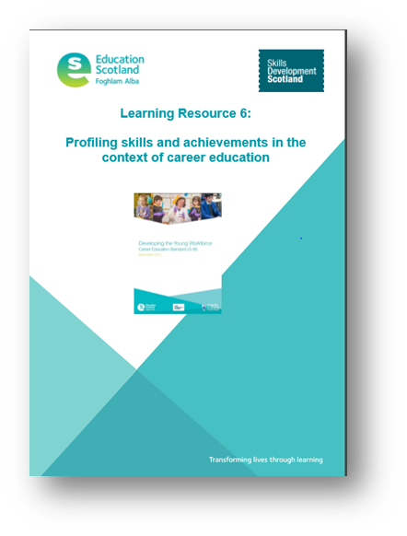
Profiling Skills and Achievements Guidance (Education Scotland)
‘… to provide children and young people with the understanding and tools to develop, capture and articulate their skills and achievements…’;
‘….to consider the development, monitoring, tracking and recording of achievements both within and out with school…’;
‘Teachers and practitioners should work closely with parents to support learners in the profiling process by discussing …. their learning, achievements and aspirations.’
‘A learner’s profile … may contain:
relevant achievements or experiences out with a formal education such as community engagement, voluntary work , youth awards etc. ’

Slide 14


Scotland’s Future Skills
Action Plan

Slide 15
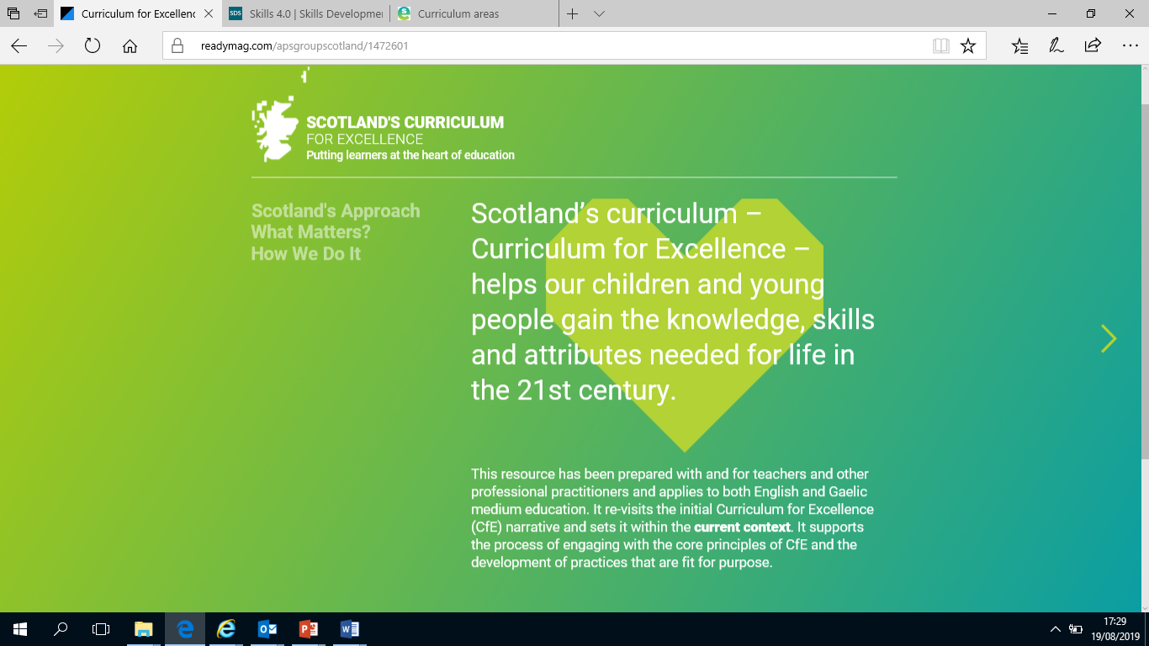
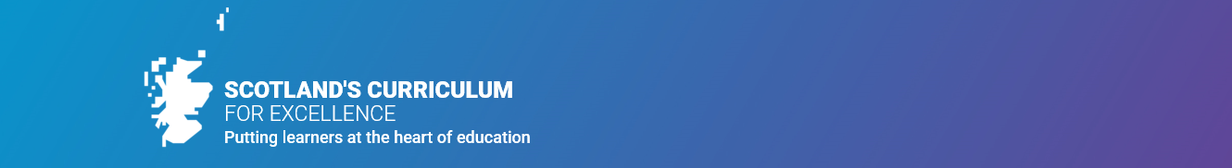

Slide 16
National Working Group on Recognising Wider Learning and Achievement
Bringing together schools, youth work, SDS, SQA and other stakeholders to:
Identify and share good practice around capturing and recognising wider learning and achievement
Consider what national advice and support will help to realise Recommendation 1 in the Learner Journey Review.

Slide 17
National Working Group on Recognising Wider Learning and Achievement
Some of the examples so far:
Kingussie High School: Online Learner Profiles/Visual CVs
Newbattle High School: Preparing digital solutions
Awards Network: Current experiences from members of partnerships with schools and capturing learning & achievement in non-formal settings
Sanderson High School: Tools to recognise wider achievement and skills in ASN settings
Larbert High School: Skills framework
Ormiston Primary School: Recognising achievement from a young age
SQA qualifications that recognise wider learning and achievement
SDS Links to Skills 4.0 and new profiling tool on MWOW

Slide 18

My World of Work: New Profile Tool

Slide 19
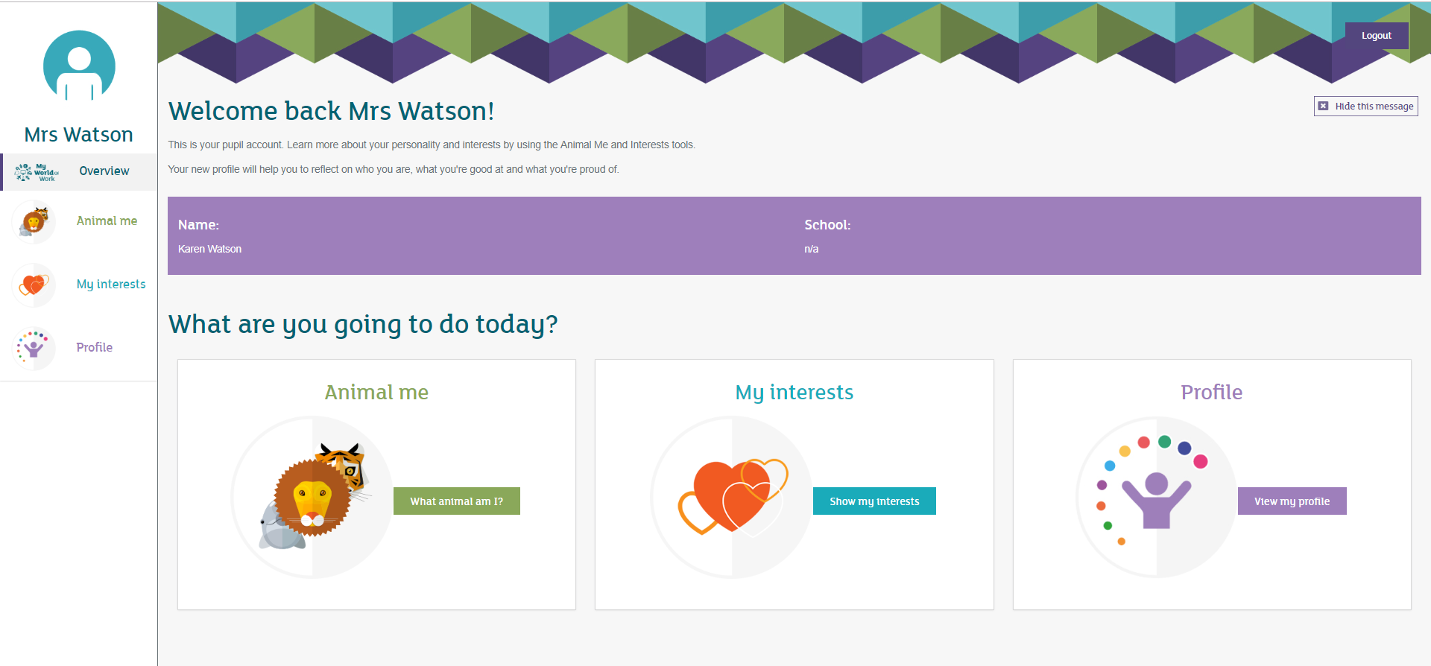
ICan P7 Profile
Title

Slide 20
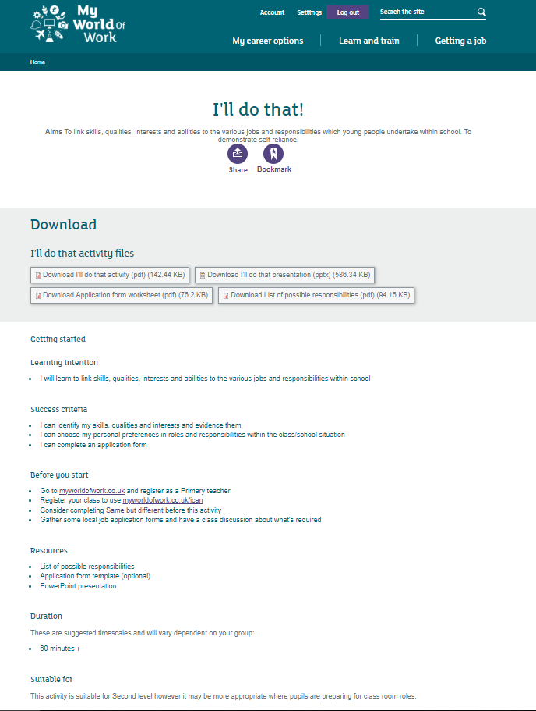
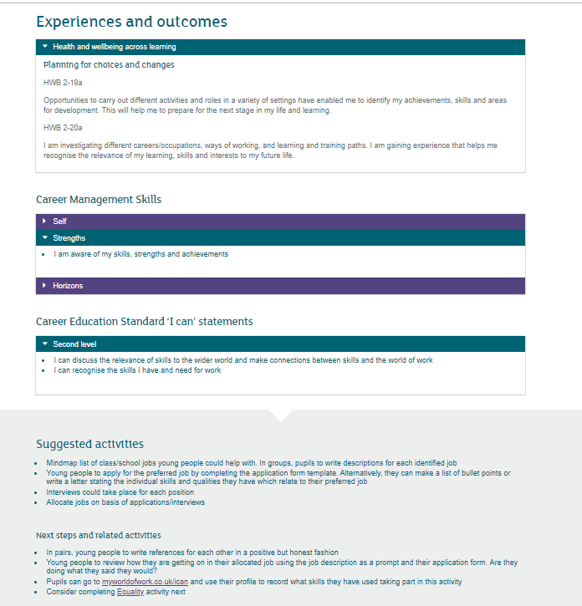
Primary teacher resources
Title

Slide 21
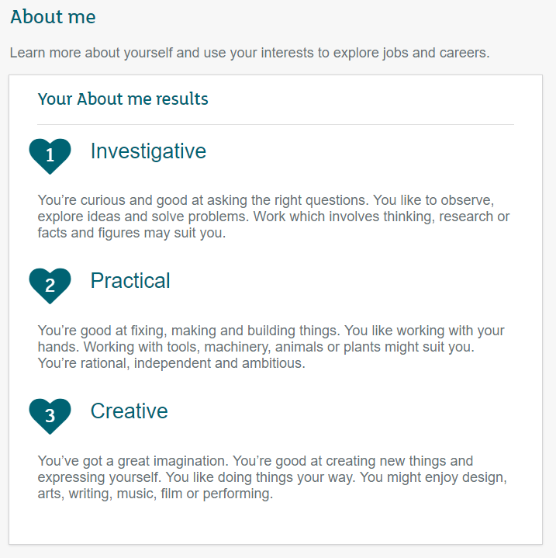
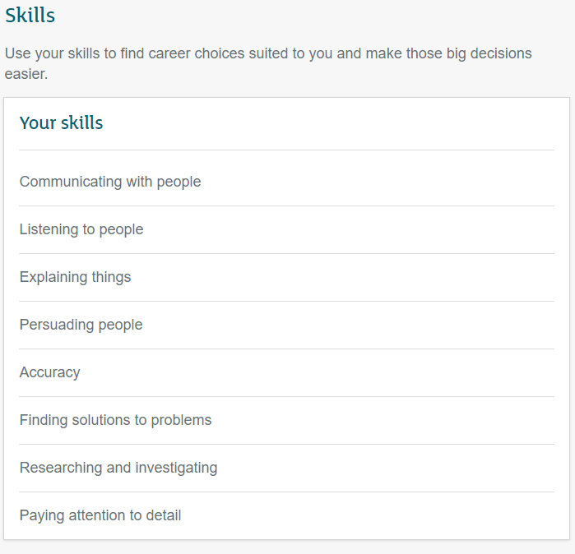
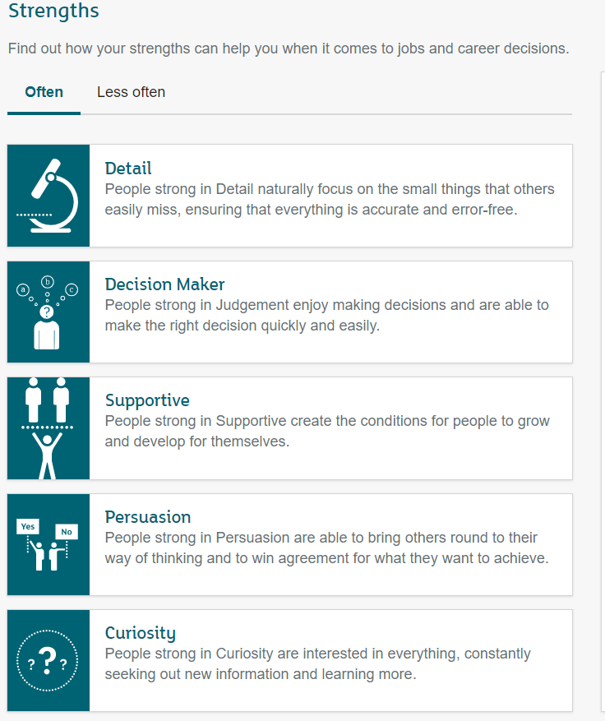
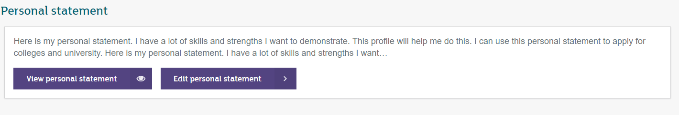
My World of Work – the profile
Title
Notes:
Developed in conjunction with Education Scotland, schools and colleges
Available to users with secondary school & college/uni roles on the site
Helps users evidence use of their about me, strengths and skills results
Apply for college or uni
Use in a job application
Will eventually power the CV

Slide 22


Skills tool - features
Current
Future
Updated skills list
  mapped to meta skills 4.0 work
  mapped to job profiles
Ability to upload evidence
Skills dashboard
Skills examples
Structured resources for teachers
Title
Outdated skills list
No way to evidence skills, essentially just a pick list
Least used tool of the three core tools
Notes:
Benefit
Allow people to understand how their skills develop over time

Slide 23
Skills tool – benefits
Skills examples will give users context to help them pick out the relevant skills
Dashboard will allow users to evidence the skills they are developing
Updated teacher resources – provide examples of how to use the skills tool in lessons and PSE

Slide 24
Scoping the issues: Some of the questions we’ve looked at
What does wider learning & achievement mean to young people, families, schools, employers, universities/colleges?
How important is it to closing the attainment gap & building young people’s skills?
How can schools, CLD/youth work providers and others work together to maximise wider learning opportunities - in school and in communities?
How can young people ‘own’ their wider learning & achievement?
What are the key components of effective learner profiles?
What existing models can we showcase to support developments in this area?

Slide 25
Key messages coming through so far…
Many schools & CLD/youth work providers are collaborating to maximise non-formal opportunities for young people to learn & achieve - in school & in their communities.
Many young people value wider learning & achievement but there is more to be done to make sure that all young people, families, teachers and practitioners, employers and HE/FE are aware of that value.
Wider learning & achievement provides great opportunities for young people to develop the ‘meta’ skills they need.

Slide 26
Key messages coming through so far…
It’s not always about formal qualifications. The increasing profile of Youth Awards is an important part of the picture.
It’s important to build in opportunities for young people to discuss and reflect on their wider learning and achievements.
Young people should be encouraged to ‘own’ their learning - profiling tools & conversations should emphasise this.

Slide 27
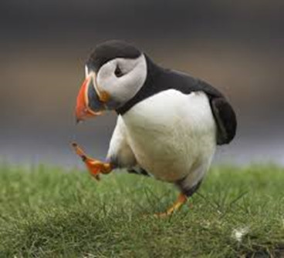
Next Steps
Developing a learning resource for practitioners
Purpose
Background
What does Wider Learning and Achievement look like?
Why is Wider Learning and Achievement important?
Who supports Wider Learning and Achievement?
Who ‘owns’ Wider Learning and Achievement?
Next Steps: A small test of change

Slide 28
Learning Resource: Wider Learning and Achievement
Proposed learning outcomes
As a result of engaging with this learning resource you will:
Gain an understanding of what is meant by wider learning and achievement
Be able to reflect on your current practice by considering a wider learning and achievement in a variety of contexts and forms
Be able to consider the development, monitoring, tracking and recording of achievements, both attainment of qualifications and wider achievements within school and in the wider community.
Gain an understanding of the partners and resources that are available to support wider learning and achievement in your context

Slide 29

#SLF19: Recognising Wider Learning and Achievement
Developing Employability and Skills-Profiling
Ian Adamson, Head Teacher, Kingussie High School
Kingussie High School Approach

Slide 30
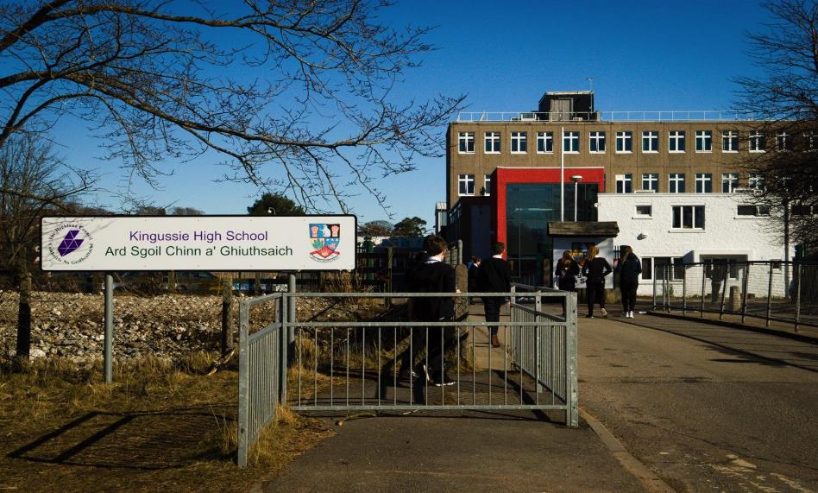
Bit of background...

Slide 31


Slide 32
WIDER ACHIEVEMENT REPORTS

Slide 33
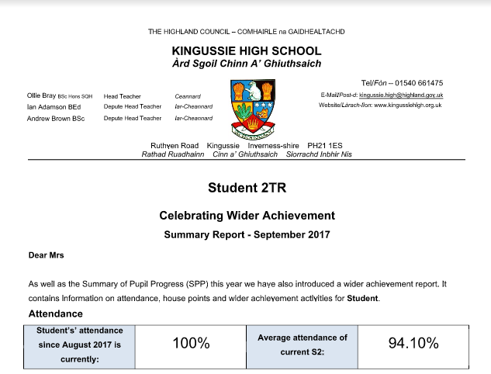

Slide 34
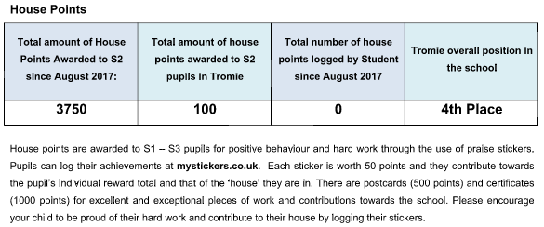

Slide 35


Slide 36
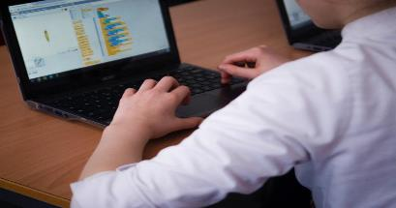
ePortfolios

Slide 37
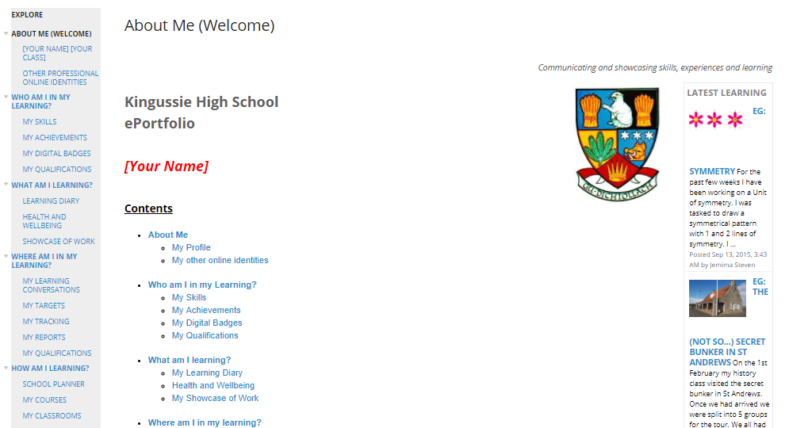

Slide 38

Welcome Hannah & Hamish Henderson
To Tell You about Their Experience

Slide 39
LEARNER JOURNEY INTERVIEWS

Slide 40
S3 - ALL PUPILS
S4 - Targeted
S5 - Targeted

Slide 41
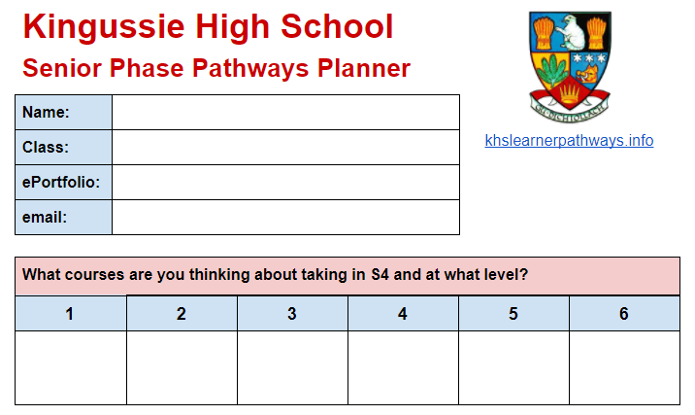

Slide 42
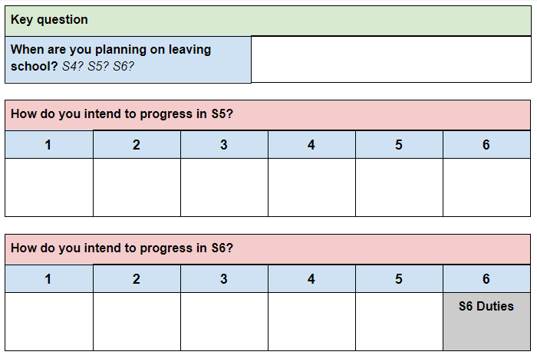

Slide 43
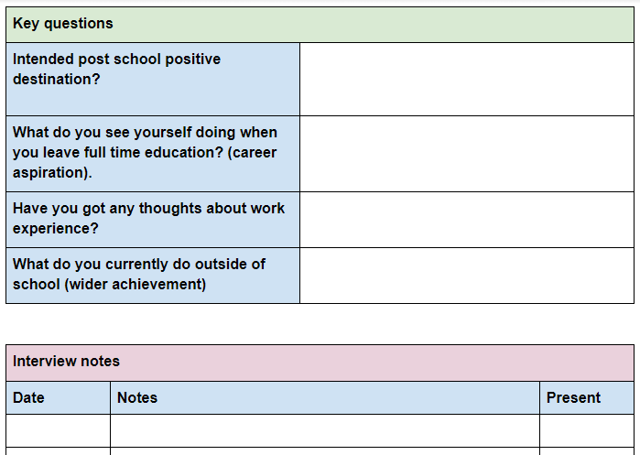

Slide 44
Visual CV’s

Slide 45
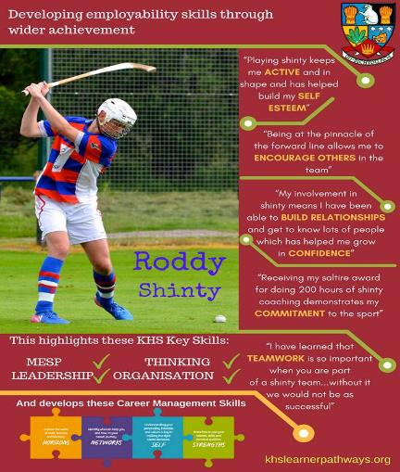
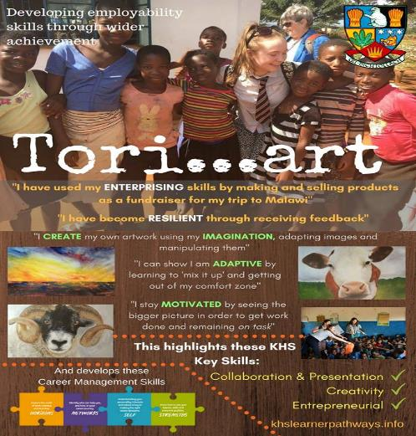

Slide 46
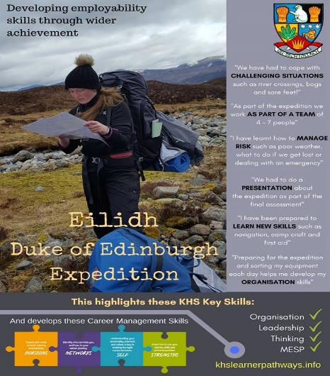
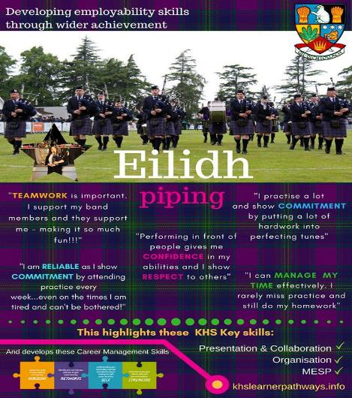

Slide 47
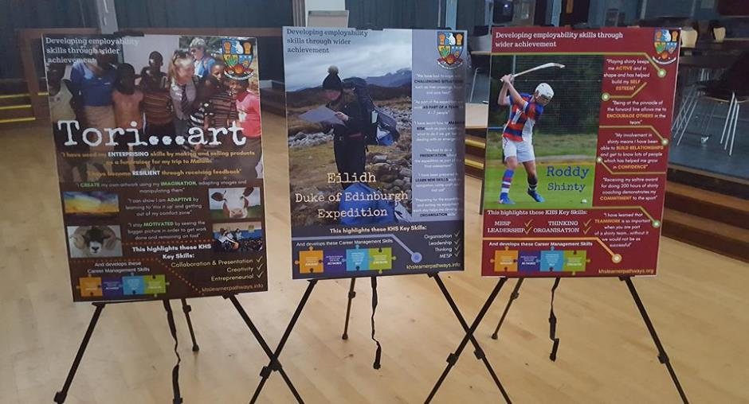

Slide 48
POSITIVE DESTINATIONS AT KHS

Slide 49

Contact Info:
Ian Adamson (Head Teacher)
Ian.adamson@kingussiehigh.org.uk

Slide 50
SLF19: Recognising Wider Learning and Achievement
Developing a Resource and Guidance
Your Views

Slide 51
Next Steps Discussion
Pick one of the questions that the national group has looked at and discuss with the person next to you for 5 mins.
Agree one key message from your discussion an write on a post-it to share with the group and/or give it to us.

Slide 52
Scoping the issues: Some of the questions we’ve looked at
What does wider learning & achievement mean to young people, families, schools, employers, universities/colleges?
How important is it to closing the attainment gap & building young people’s skills?
How can schools, CLD/youth work providers and others work together to maximise wider learning opportunities - in school and in communities?
How can young people ‘own’ their wider learning & achievement?
What are the key components of effective learner profiles?
What existing models can we showcase to support developments in this area?

Slide 53

Next Steps: Get Involved
If you would you like to contribute to the development of this area of work – e.g. sharing your experiences with the national group or helping to trial the learning resource – then please leave us your name and contact details on a post-it.

Slide 54
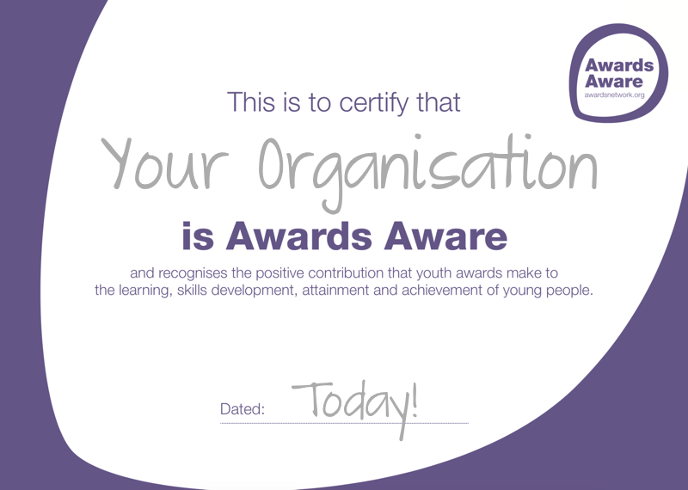
Notes:
Awards Aware is a statement of support, recognising and valuing youth awards as evidence of learning, attainment and achievement.
There is no cost involved. Your school / organisation can support through a simple on-line sign up through the Awards Network website.
An endorsement statement would be appreciated, illustrating how you use / value / recognise achievement through youth awards.
Sign-up requires accepting a set of core principles and a set of aspirations specific to your setting.

