Slide 1
Harnessing Youth Awards to Recognise and Accredit Wider Learning and Achievement
Jim Duffy, Awards Network
@Awards_Network
with
John Galt, Education Scotland
@edscot
#YLSConf19

Slide 2
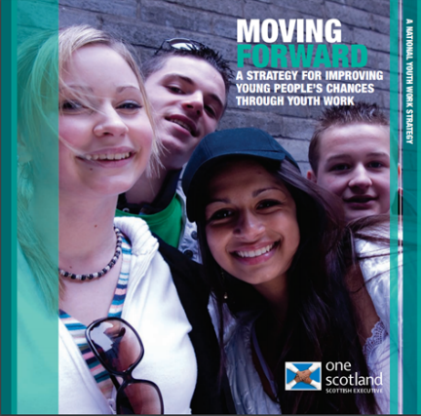
Awards Network - Background
2007 - Scotland’s first National Youth Work Strategy launched
Recognise achievements of young people through youth work
Action Plan on Volunteering
The Awards Network
2015 - HMIe Aspect Review

Slide 3
What is the Awards Network?
A forum of providers of non-formal learning awards in Scotland
Awards that use youth work approaches and are available to young people aged between 10 to 25 across Scotland
Members work together to raise awareness, and promote recognition, of achievements of young people gained through youth awards

Slide 4
Purpose and Vision
Our Purpose: to promote the participation and achievements of young people gained through youth work awards
Our Vision: Awards are widely valued and recognised as critical evidence of every young person’s learning and achievement

Slide 5
Awards Network Members ( September 2019)
Notes:
Membership of the Awards Network includes major national youth work organisations; a range of niche organisations and award bodies harnessing youth work approaches to support attainment through non-formal learning

Slide 6
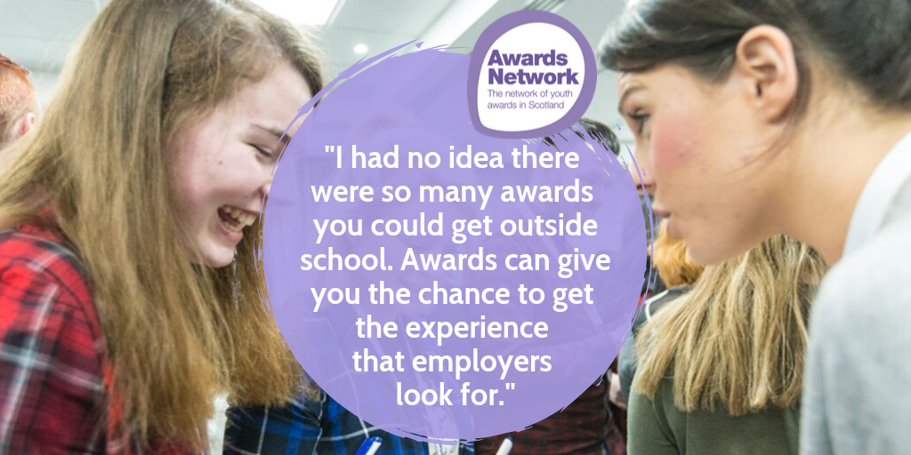

Slide 7
AMAZING THINGS
A Guide to Youth Awards In Scotland
First edition in 2008
4th edition in 2017 features:
26 Awards Network members
48 awards programmes
18 SCQF credit rated awards
>73,000 awards completed in 2014/15
>115,000 awards completed in 2018/19
Notes:
Introduce Amazing Things – A guide to youth awards in Scotland
Highlight the information contained within it, including the table towards the back that highlights where external accreditation is available.
As this publication was released at SLF 2017, more up to date information, including additional awards, can be found on the Awards Network website

Slide 8
Harnessing Youth Awards to Recognise and Accredit Wider Learning and Achievement
Opportunities for multiple recognition / accreditation
Youth Awards providing evidence for SQA Achievement Awards
John Muir Award – evidence for Personal Development Awards (SCQF 4); Wellbeing awards(SCQF 5)
Girlguiding Young Leader Award and SQA Leadership Award (SCQF 5)
DofE and SQA Volunteering Awards (SCQF 3-5)
STEM Learning
Youth Scotland Hi5 Award (SCQF 2)
Scouts – activity badges meeting requirements for CREST awards
Young STEM Leader Award (in pilot stage for SCQF 6 and CfE Level 2)

Slide 9
An Entitlement to RECOGNISING ACHIEVEMENT
‘All children and young people are entitled to have the full range of their achievements recognised’ (Building the Curriculum 5)
Notes:
The first statement of ‘entitlement’ to recognition of achievements

Slide 10
RECOGNITION AND ACCREDITATION: What Young People Say…
Extra-curricular activities should be better recognised by employers, universities, and other opportunity providers, as equally important to academic qualifications.
Young people should be able to present a well-rounded portrait of themselves as an individual to potential employers and universities, reflecting their interests, hobbies, aspirations, and volunteering activity.
More value needs to be attached to the skills developed through practical volunteering experience and other activities.
Schools could partner with youth groups to co-deliver a skills education programme.
#SQA Futures, Young Scot/SQA, October 2018

Slide 11
The National Working Group on
Recognising Wider Learning and Achievement
John Galt, Education Scotland
@edscot
#YLSConf19

Slide 12
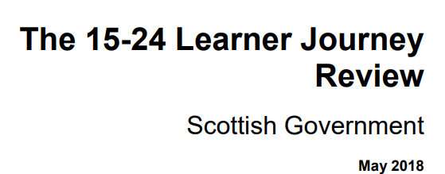
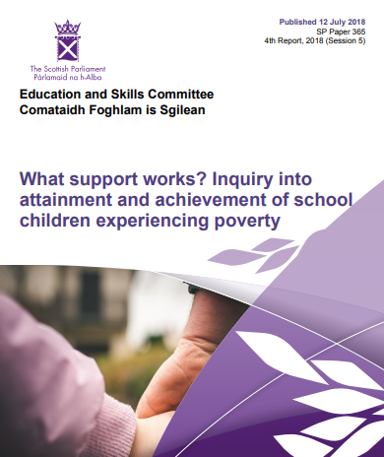
Background:
Context
Notes:
Non-formal learning youth awards contribute across a range of policy areas: recognizing achievement; improving attainment and supporting skills development of learning , life and work

Slide 13
Background:
Learner Journey Review
Recommendation 1:
We will ensure every learner in Scotland has an online learner account to link their skills and attributes to better course choices.
The approach is expected to ‘recognise wider achievements and informal learning, so that all young people have the opportunity to develop a personal statement and clearly articulate the skills gained and achievements made whilst in school.’

Slide 14
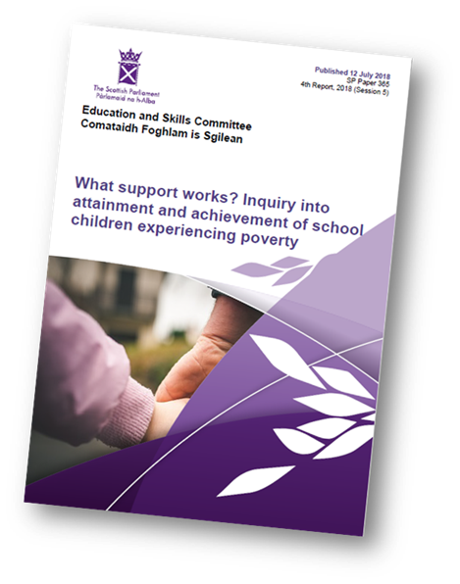
Background: Legacy from the Year of Young People 2018
To increase parity of esteem between formal qualifications and the skills and experiences that all young people gain through wider learning.
Recommends that ….Education Scotland publishes a detailed plan, …. on the work they
are undertaking to ensure wider learning is accredited appropriately.’

Slide 15
Career Education Standard 3-18
Children and young people will be entitled to:
…..develop skills for learning, life and work as an integral part of their education and be clear about how all their achievements relate to these

Slide 16
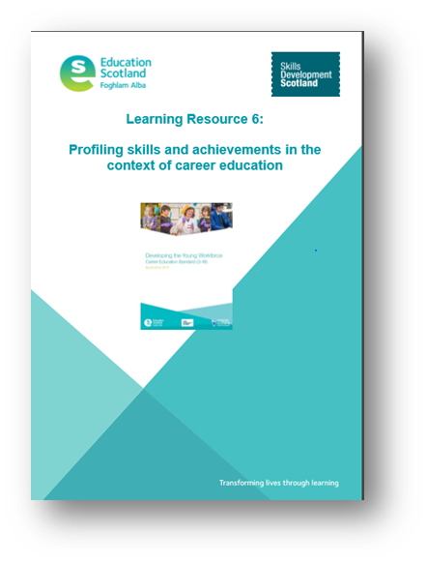
Profiling Skills and Achievements Guidance (Education Scotland)
‘… to provide children and young people with the understanding and tools to develop, capture and articulate their skills and achievements…’;
‘….to consider the development, monitoring, tracking and recording of achievements both within and out with school…’;
‘Teachers and practitioners should work closely with parents to support learners in the profiling process by discussing …. their learning, achievements and aspirations.’
‘A learner’s profile … may contain:
relevant achievements or experiences out with a formal education such as community engagement, voluntary work , youth awards etc.’

Slide 17
My World of Work: New Profile Tool

Slide 18
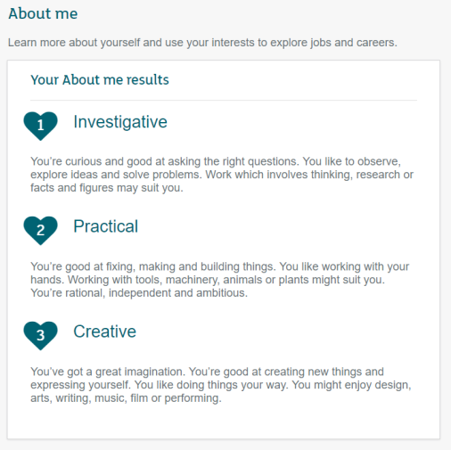
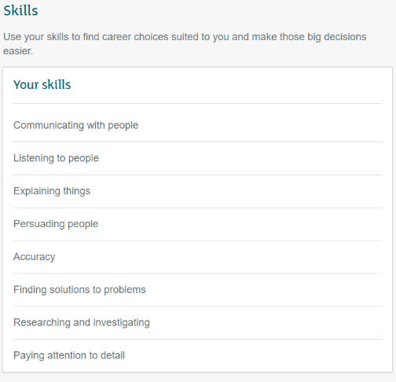
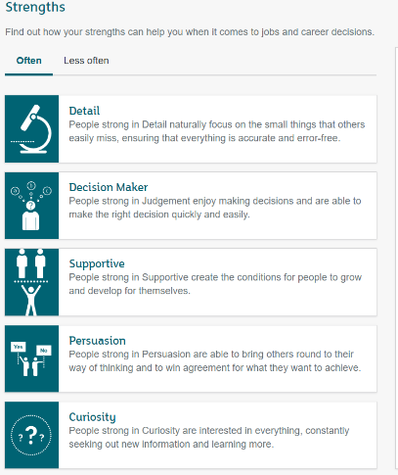
My World of Work – the profile
Title
Notes:
Developed in conjunction with Education Scotland, schools and colleges
Available to users with secondary school & college/uni roles on the site
Helps users evidence use of their about me, strengths and skills results
Apply for college or uni
Use in a job application
Will eventually power the CV

Slide 19
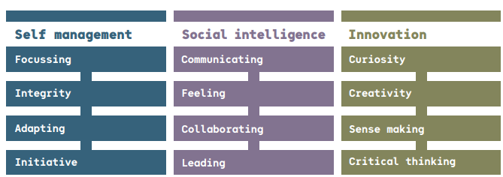
Developing Employability Skills
Skills for the future: meta-skills (Skills 4.0 - SDS)
Manage the Now | Connect with the World | Create our own change

Slide 20
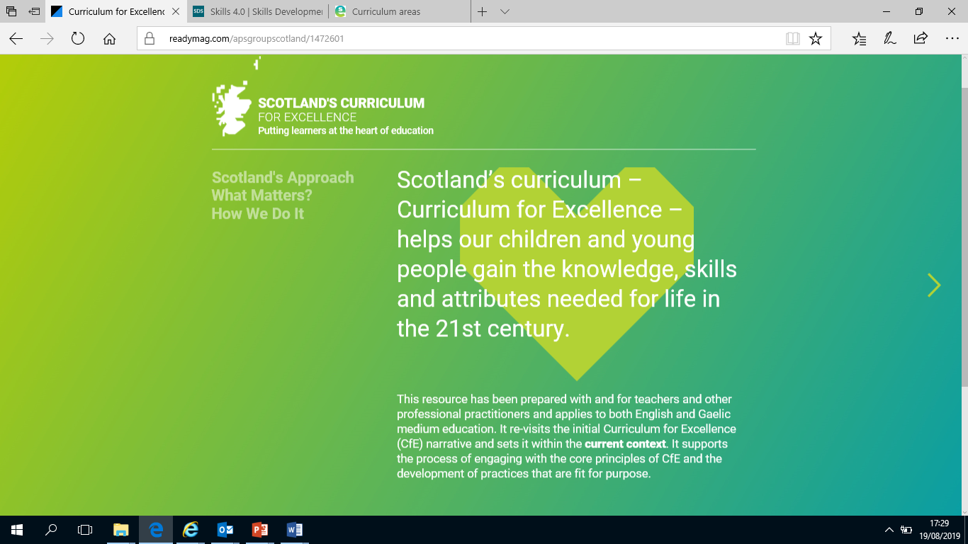

Slide 21
National Working Group on Recognising Wider Learning and Achievement
Bringing together schools, CLD / youth work, Education Scotland, SDS, SQA and other stakeholders to:
Identify and share good practice around capturing and recognising wider learning and achievement
Consider what national advice and support will help to realise Recommendation 1 in the Learner Journey Review

Slide 22
Scoping the issues: Some of the questions we’ve looked at
What does wider learning & achievement mean to young people, families, schools, employers, universities/colleges?
How important is it to closing the attainment gap & building young people’s skills?
How can schools, CLD/youth work providers and others work together to maximise wider learning opportunities - in school and in communities?
How can young people ‘own’ their wider learning & achievement?
What are the key components of effective learner profiles?
What existing models can we showcase to support developments in this area?

Slide 23
National Group: Key messages coming through so far…
Many schools & CLD/youth work providers are collaborating to maximise non-formal opportunities for young people to learn & achieve - in school & in their communities.
Many young people value wider learning & achievement but there is more to be done to make sure that all young people, families, teachers and practitioners, employers and HE/FE are aware of that value.
Wider learning & achievement provides great opportunities for young people to develop the ‘meta’ skills they need.

Slide 24
National Group: Key messages coming through so far…
It’s not always about formal qualifications. The increasing profile of Youth Awards is an important part of the picture.
It’s important to build in opportunities for young people to discuss and reflect on their wider learning and achievements.
Young people should be encouraged to ‘own’ their learning - profiling tools & conversations should emphasise this.

Slide 25
National Group: Next Steps
Developing a Learning Resource for Practitioners to:
Increase the understanding of wider learning and achievement as part of Scotland's Curriculum
Be able to reflect on your current practice by considering a wider learning and achievement in a variety of contexts and forms
Be able to consider the development, monitoring, tracking and recording of achievements, both attainment of qualifications and wider achievements within and out with school ‘learning out with the school, including in the wider community.’
Gain an understanding of the partners and resources that are available to support wider learning and achievement in your context

